Slide 1
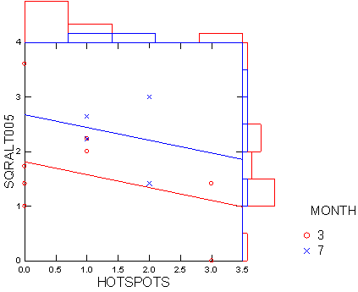
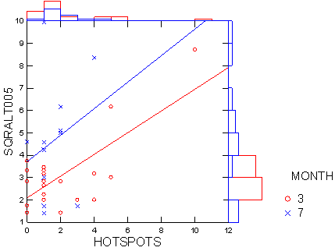
Normalized Mutations versus hotspots
No UV
UV

Slide 2
UV -- ANCOVA
Dependent Variable | SQRALT005
N | 35
Multiple R | 0.595
Squared Multiple R | 0.354
Variables | Levels
MONTH (2 levels) | 3.000 | 7.000
UV$ (1 levels) | UV
Estimates of Effects B = (X'X)-1X'Y
Factor | Level | SQRALT005
CONSTANT |  | 2.976
MONTH | 3 | -0.895
HOTSPOTS |  | 0.496
Analysis of Variance
Source | Type III SS | df | Mean Squares | F-Ratio | p-Value
MONTH | 25.047 | 1 | 25.047 | 8.268 | 0.007
HOTSPOTS | 32.884 | 1 | 32.884 | 10.855 | 0.002
Error | 96.941 | 32 | 3.029

Slide 3
No-UV ANCVOA
Estimates of Effects B = (X'X)-1X'Y
Factor | Level | SQRALT005
CONSTANT |  | 2.246
MONTH | 3 | -0.432
HOTSPOTS |  | -0.236
Variables | Levels
MONTH (2 levels) | 3.000 | 7.000
UV$ (1 levels) | No UV
Dependent Variable | SQRALT005
N | 19
Multiple R | 0.446
Squared Multiple R | 0.199
Analysis of Variance
Source | Type III SS | df | Mean Squares | F-Ratio | p-Value
MONTH | 2.077 | 1 | 2.077 | 3.564 | 0.077
HOTSPOTS | 0.907 | 1 | 0.907 | 1.556 | 0.230
Error | 9.324 | 16 | 0.583

Slide 4
Issues
There are hotspots, mutation burden and size
Structured equation analysis?
Size can drive hotspots and mutation burden
Chicken and egg: hotspots versus mutations?

Slide 5
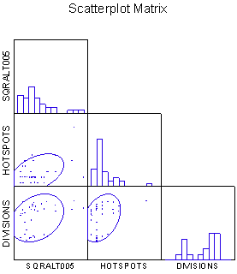
Correlation Matrix: Hotspots, Size, Mutations
Pearson Correlation Matrix
 | LOG2VOLUME | SQRALT005 | HOTSPOTS
LOG2VOLUME | 1.000
SQRALT005 | 0.297 | 1.000
HOTSPOTS | 0.348 | 0.433 | 1.000
Means
LOG2VOLUME | SQRALT005 | HOTSPOTS
21.738 | 3.601 | 1.829

